Slide 1
analysing the Financial Performance of the top 12 German Companies BETWEEN 2017-2024

Slide 2
Group 4
Devata Shravya – 2023JULB01107
Bidisha Gogoi – 2023JULB01242
Shreya Parekh – 2023JULB1169
Shakshi Choudhary – 2023AUGVPGP0002
Shruti Jain – 2023JULB01306

Slide 3
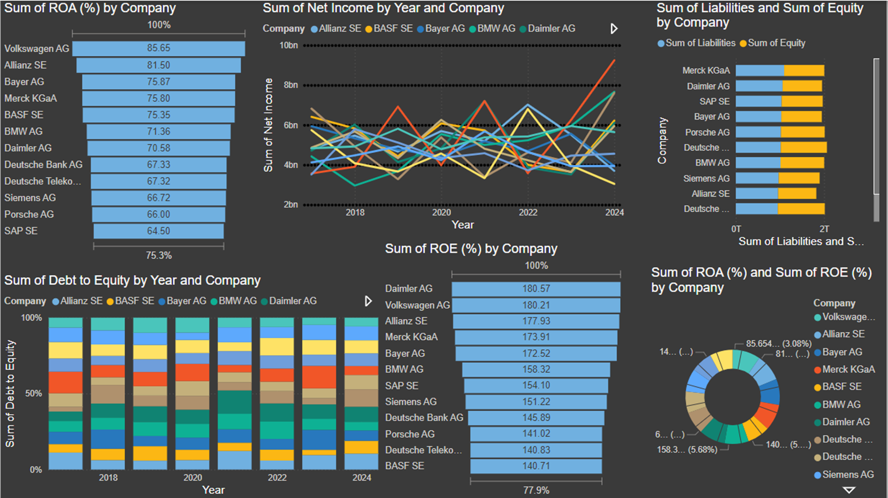

Slide 4
The dashboard presents financial performance metrics for various companies over the years 2018 to 2024. The metrics include Return on Assets (ROA), Return on Equity (ROE), Net Income, Debt to Equity, and Liabilities and Equity.
Top ROA Performers: Volkswagen AG leads in ROA (85.65%), showcasing efficient asset utilization. Allianz SE and Bayer AG also perform strongly, indicating good operational efficiency.
ROE Leaders: Daimler AG and Volkswagen AG exhibit the highest ROE (180.57% and 180.21%, respectively), demonstrating effective shareholder fund utilization.
Leverage Overview: Debt-to-equity ratios are consistent across companies, but firms like Daimler AG and Merck KGaA demonstrate balanced liabilities relative to equity, signaling robust financial management.
Net Income Trends: Net income shows variability across years for all companies, with steady growth visible for certain firms like Allianz SE and Bayer AG.
Liabilities vs. Equity: Companies like Merck KGaA and Daimler AG maintain relatively higher equity proportions, suggesting lower risk from excessive leverage.

Slide 5
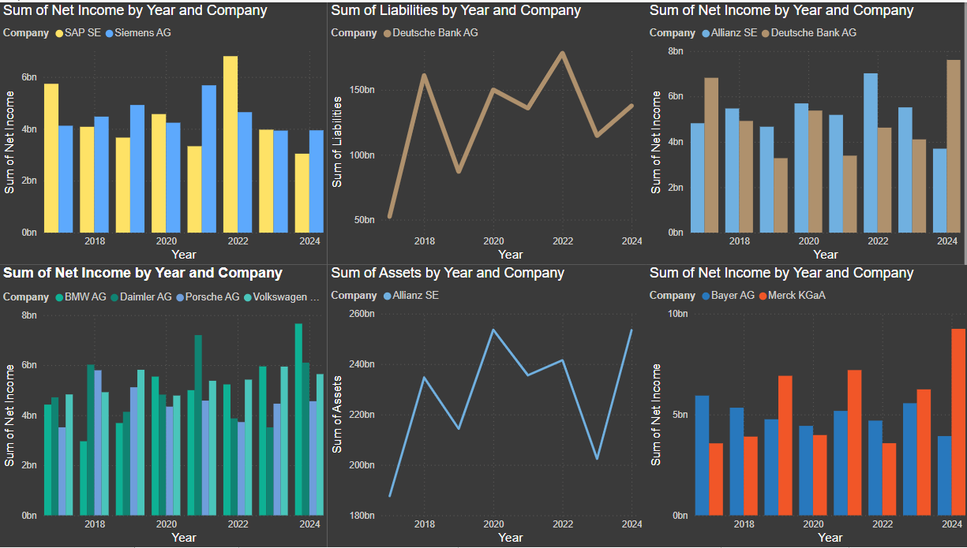

Slide 6
Net Income Trends:
Allianz SE and Deutsche Bank AG show steady growth in net income, with Allianz SE achieving consistent performance.
BMW AG, Daimler AG, and Volkswagen AG exhibit growth in net income, with Volkswagen AG outperforming in recent years.
Bayer AG and Merck KGaA show contrasting net income trends, with Merck KGaA achieving a significant surge by 2024.

Slide 7
1. Liabilities and Assets:
Deutsche Bank AG has fluctuating liabilities, indicating potential financial restructuring efforts.
Allianz SE demonstrates steady growth in assets, reflecting a robust and expanding financial base.
2. Sectoral Strengths:
The automotive sector (Volkswagen AG, Daimler AG) shows resilience in net income despite economic challenges.
Pharmaceutical companies (Bayer AG, Merck KGaA) display diverse trends, signaling varying operational efficiency

Slide 8
THANK YOU

